Slide 1
Module 3 Role of the project manager in project procurement
Mgmt 6063 – Project Procurement

Slide 2
Module agenda
Module Learning Outcomes
Understand difference between project procurement and generic/operational procurement
Understand the role of the project manager in procurement
Explore project procurement best practices
Recognize the difference between traditional and partnering procurement relationships
Homework/evaluations

Slide 3
Project procurement vs generic/operational procurement
Project procurement may involve factors not present in operational procurement, such as:
Project procurement scheduling - delivery of resources during a project can be complex including many dates and locations during the project
Projects may require new suppliers the organization has not used before, possibly in new supplier categories
More detailed tracking of procured resources may be required such as shipments on job sites

Slide 4

Role of the project manager
Understand the procurement processes in your organization, as well as the constraints/priorities of procurement staff
In-depth understanding of project scope and procurement needs (including human resources)
Make-or-buy decision
Research criteria for items that need to be procured
Develop procurement documents
Identification of suitable sellers
Evaluation of sellers
Contract management and seller performance monitoring
Documentation and closeout of contracts
Notes:
Image vectorstock.com

Slide 5

project procurement best practices
Well-defined requirements and procedures
Extensive training and team-building activities
Well-established conflict management processes in place
Frequent review and status updates
Co-location when needed
Fair and incentive-laden contracts
Long-term outsourcing relationships
Notes:
Reference - Lawson … Image userguiding.com

Slide 6
Best practices case study
Handout or Word doc
Read the case study provided.
What best practices were evident in the case? How did they contribute to project objectives?
M3 - Case Study Handout.docx

Slide 7

Project Partnering
The process of transforming contractual arrangements into a cohesive, collaborative team that deals with issues and problems encountered to meet a customer’s needs.
Assumes that the traditional adversarial relationship between the owner and contractor is ineffective and self-defeating.
Assumes that both parties share common goals and mutually benefit from the successful completion of projects.
Factors favouring partnering:
Motivated by common goals
Avoid high costs of the adversarial approach
Shared benefits of the collaborative approach
See Slide Notes
Notes:
Image ft.com
Partnering is the process of transforming contractual arrangements into a cohesive, collaborative team that deals with issues and problems encountered to meet a customer’s needs.
Partnering assumes that
The traditional adversarial relationship between the owner and contractor is ineffective and self-defeating.
Both parties share common goals and mutually benefit from the successful completion of projects.
Factors favoring the development of partnering:
Existence of common goals
High costs of the adversarial approach
Shared benefits of the collaborative approach

Slide 8
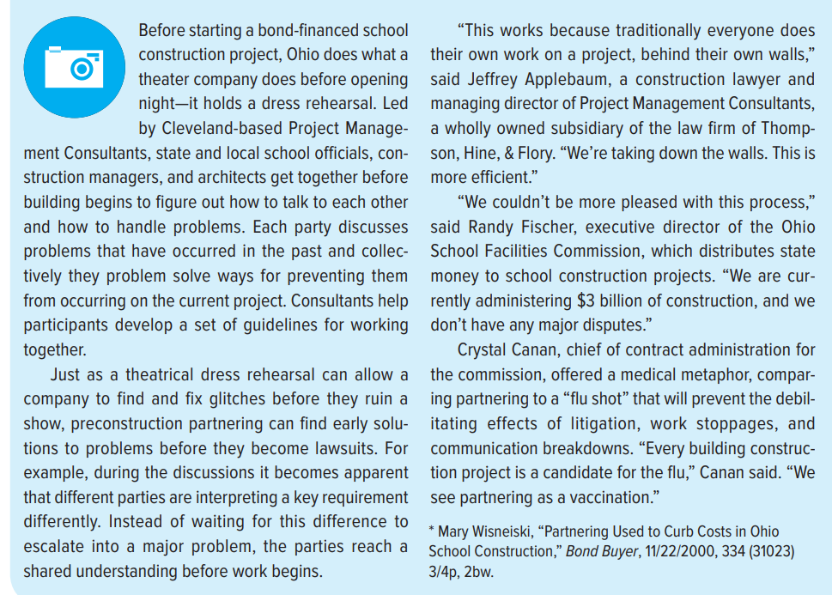
Partnering case study

Slide 9
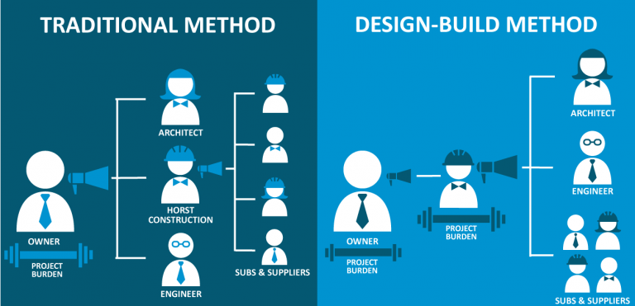

Project Partnering
Design-Build
(3:27min).
Click here.
Notes:
Image raywestdesignbuild.com

Slide 10
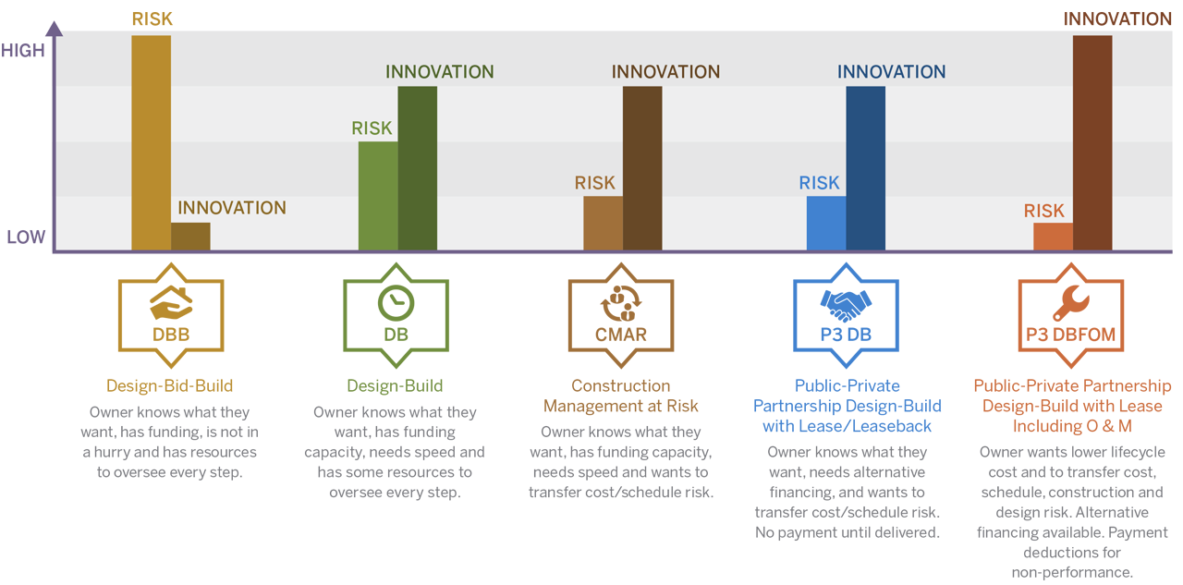
Types of partnering relationships
Risk to owner/ customer
Notes:
Image - http://www.sehinc.com/news/dbb-db-or-ppp-how-pick-best-project-delivery-method

Slide 11
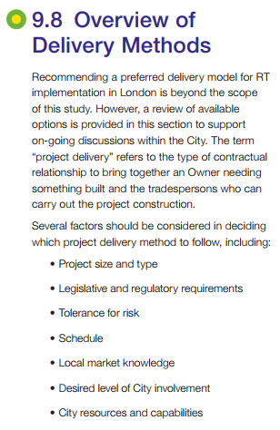
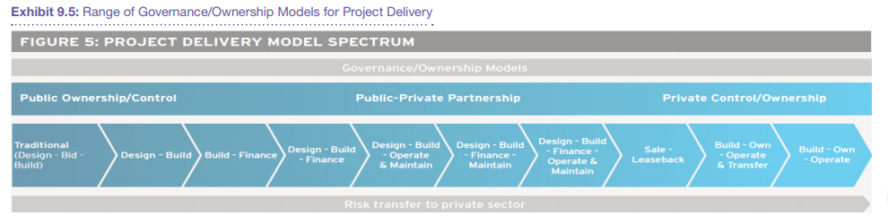
Delivery Model for London’s transit system
Notes:
Course London.ca

Slide 12
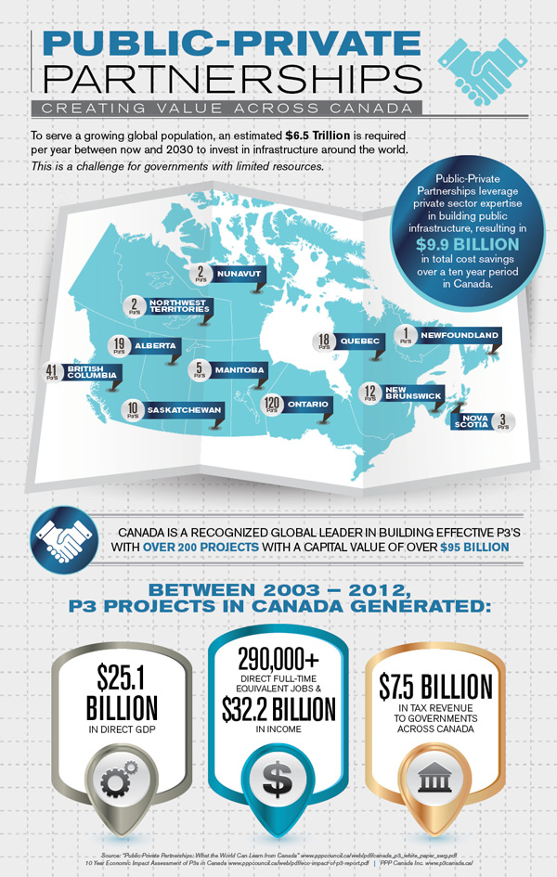
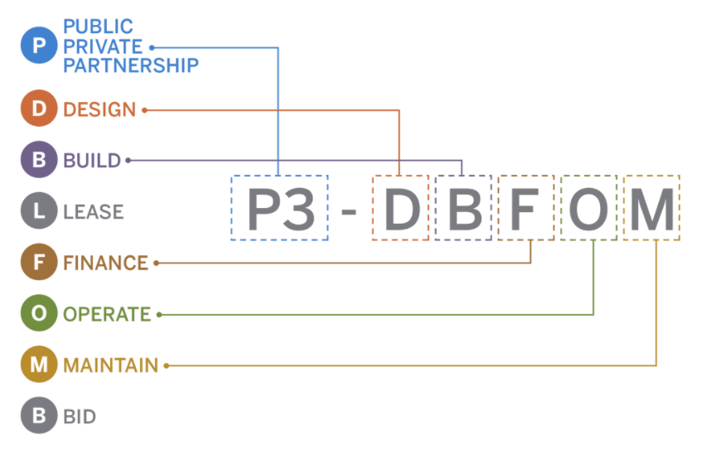
P3: public private partnerships
P3 Projects in Ontario:
Infrastructure Ontario Projects
Notes:
Image - http://www.sehinc.com/news/dbb-db-or-ppp-how-pick-best-project-delivery-method
https://www.pppcouncil.ca/web/P3_Knowledge_Centre/Research/Public-Private_Partnerships___What_the_World_can_Learn_from_Canada.aspx

Slide 13
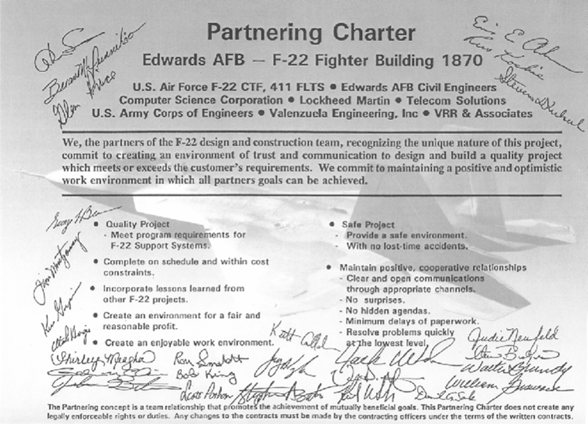
The partnering charter
See Slide Notes
Notes:
Image – Lawson….see references slide.
This image is an example of a partnering charter. You can see signatures of all the partners involved with this charter to build the F22 fighter aircraft for the U.S. Air Force. The charter demonstrates the commitment to work as a team. Some of the details of the charter are provided on this image such as “creating an environment of trust and communication …”.

Slide 14
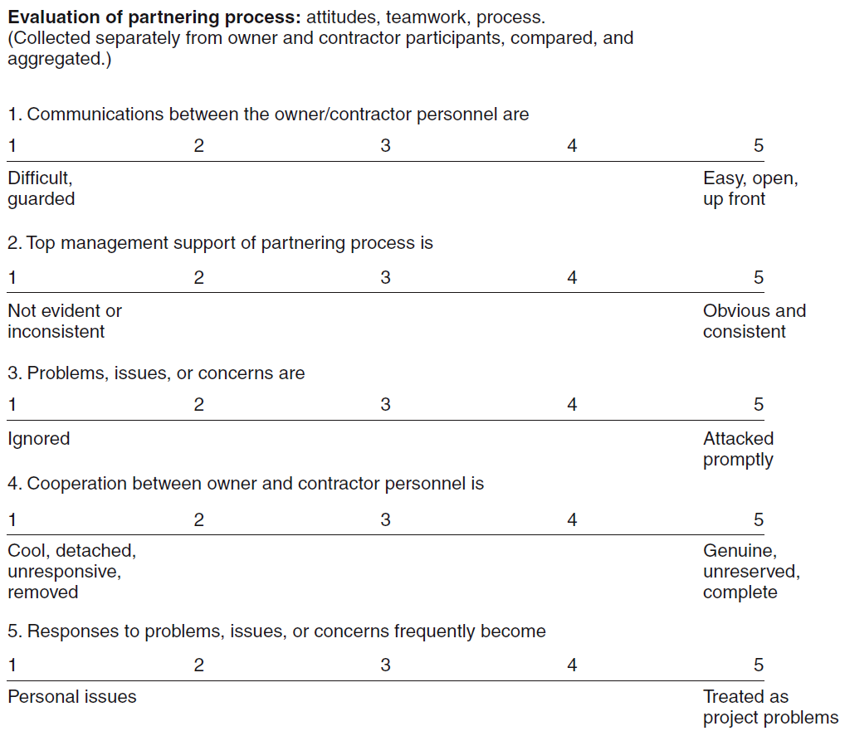
Partnering survey
You may need to work with the partner again. Successful project completion means there is a possibility of building a long-term relationship with the partner – lowering risk but possibly increasing costs.
Notes:
Image – Lawson…see references slide

Slide 15
Summary of our journey today
Project procurement vs generic/operational procurement
Role of the project manager
Project procurement best practices
Project partnering

Slide 16
Homework and evaluations
Readings for next module as listed in Course Overview

Slide 17
references
Project Management Institute (2017). A Guide to the Project Management Body of Knowledge (Sixth Edition).
Kerzner, Harold (2017). Project Management, Twelfth Edition.
Watts, A. (2014). Project Management. Victoria, B.C.:BCcampus. Retrieved from https://opentextbc.ca/projectmanagement/.
Larson, Eric W., Gray, Clifford F. (2018). Project Management, The Managerial Process (Seventh Edition).

